Slide 1
Major Project
Detection of COVID – 19
Using X-ray Images
Supervisor –
Sarosh Umar Sir
YASH VARSHNEY
HRITICK GOYAL

Slide 2

CONTENT
Problem Statement
Background Study
Existing Approaches
Our Approach and Work
References

Slide 3
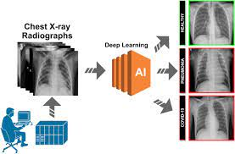
Problem Statement
Detection of covid -19 using radiological images such as X-ray images.[1]
Chest imaging is a quick and easy procedure recommended by medical and health protocols.

Slide 4
Background study
During the recent global urgency, scientists, clinicians, and healthcare experts around the globe keep on searching for a new technology to support in tackling the Covid-19 pandemic.[2]
Due to the lack of resources, time consuming and expensive methods for COVID-19 detection, We need fast, reliable and cheap solution.

Slide 5
Background study
The evidence of Machine Learning (ML) and Artificial Intelligence (AI) application on the previous epidemic encourage researchers by giving a new angle to fight against the novel Coronavirus outbreak. [2]
The ML based approach would be the best and the cheapest way for the detection of COVID-19.

Slide 6
Existing Approaches
Various deep learning based approaches have been developed to identify different thoracic diseases, including pneumonia and other infections.[3]
They apply different CNN based Machine Learning techniques for the prediction

Slide 7
Existing Approaches
Some approaches have an open source and actively maintained tool which has ability to identify COVID-19 as well as other pneumonia.[4]
We would treat such models as a baseline to compare our results and improve the efficiency of our model more than them.[5]

Slide 8
Our Approach and Work
Our Approach and Work
We have used different Deep Learning and CNN (Convolutional Neural Network) algorithms to create our model over the X-ray dataset for training the model.
We have also applied the transfer learning method to train the pre-trained model like VGG16 and MobileNet and try to compare there results to find out the best of them.[6]

Slide 9

We had collected the dataset from Kaggle i.e. COVID-19 Radiography Database
This dataset comprises of 4 categories X-ray images of patients classified as
3616 COVID-19 positive cases
10,192 Normal
6012 Lung Opacity (Non-COVID lung infection)
1345 Viral Pneumonia images.
9

Slide 10
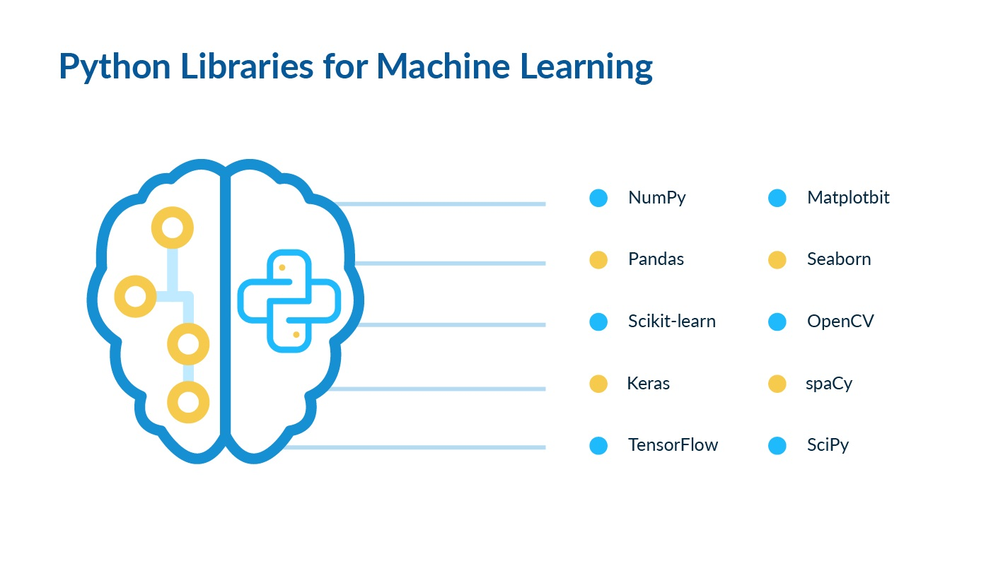
Dependencies and Libraries
We have used Python as a Language for training our Machine Learning model and the following python modules are used for ML –
Keras
TensorFlow
Pandas
Sklearn
Matplotlib
Seaborn

Slide 11
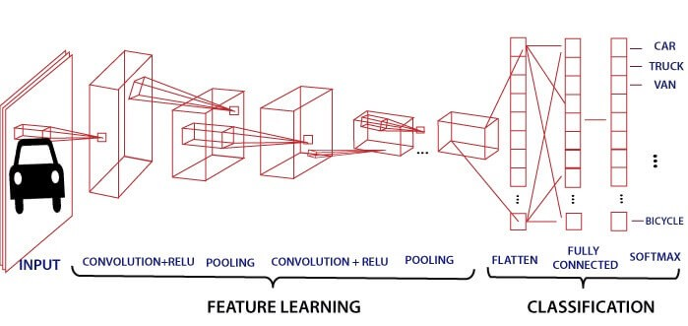
Algorithms - CNN
CNN stands for Convolution Neural Network.
Convolutional neural network (CNN) is a class of deep neural networks, most commonly applied to analyze visual imagery. The system determines which image belongs to which label based on the differences in images.
CNN consists of three different layers that are a convolutional layer, pooling layer and fully connected layer to perform these operations effectively.

Slide 12
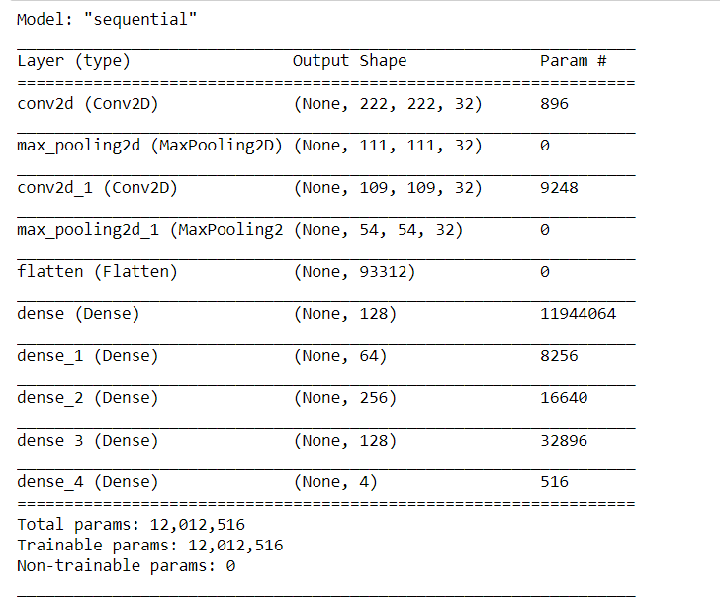
CNN-Based Approach

Slide 13
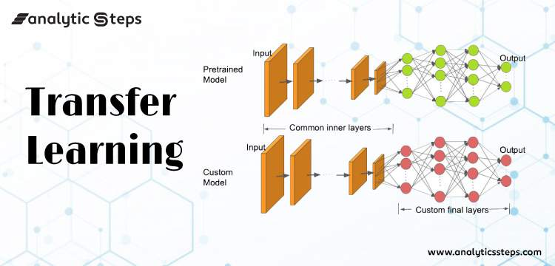
Algorithms - Transfer Learning
Transfer learning is a machine learning method where a model developed for a task is reused as the starting point for a model on a second task.
It is common to perform transfer learning with predictive modeling problems that use image data as input.
The various pre-trained models are – MobileNet, VGG16, etc.

Slide 14
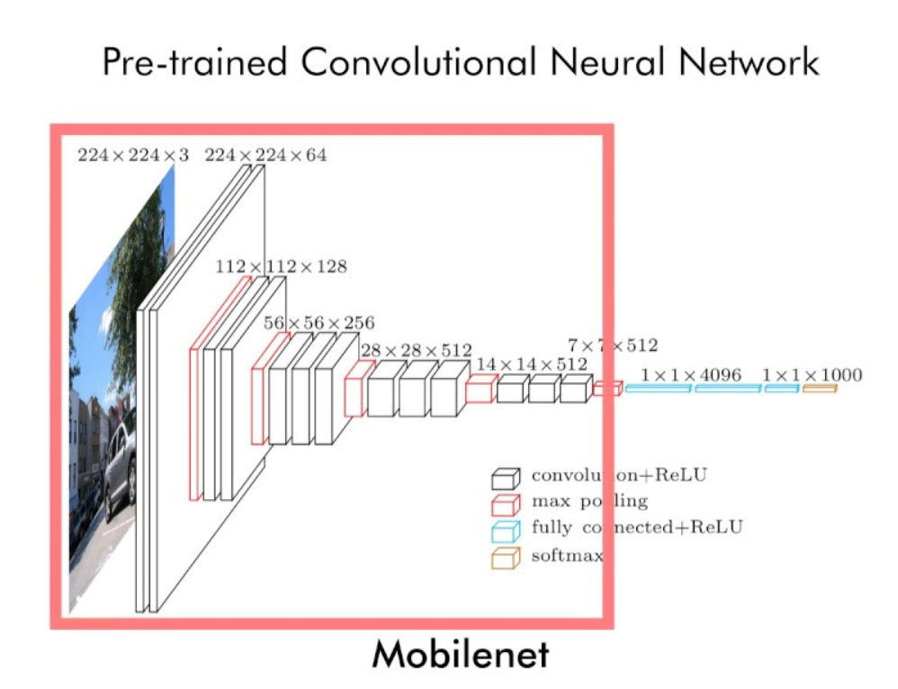
Transfer Learning - MOBILENET

Slide 15
Transfer Learning - Based Approach

Slide 16
-Based Approach

Slide 17
CNN-Based Approach

Slide 18
References
[1] Arpan Mangal, Surya Kalia, Covid AID: COVID-19 Detection Using Chest X-Ray.
[2] Deep Learning in the Detection and Diagnosis of COVID-19 Using Radiology Modalities: A Systematic Review
[3] COVID-Net: a tailored deep convolutional neural network design for detection of COVID-19 cases from chest X-ray images
[4] Wang, L., Wong, A.: Covid-net: A tailored deep convolutional neural network design for detection of covid-19 cases from chest radiography images (2020)
[5] https://github.com/JordanMicahBennett/SMART-CT-SCAN_BASED-COVID19_VIRUS_DETECTOR
[6] Transfer Learning to Detect COVID-19 Automatically from X-Ray Images Using Convolutional Neural Networks

Slide 19
Thanks

